Slide 1
Midturn Presentation
Runlin Hou
rh690

Slide 2
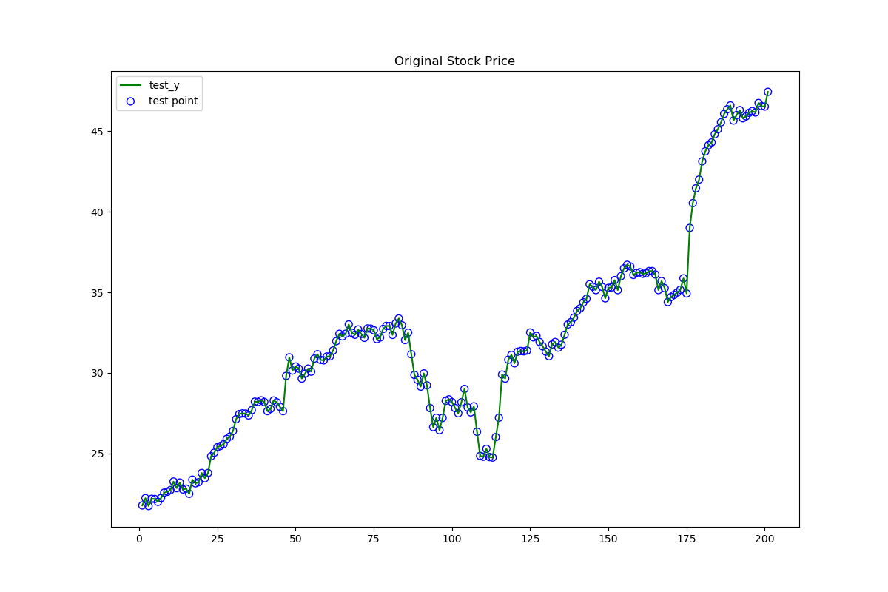
I download a year of stock price data and here I use 200 of them as training and test dataset.

Slide 3


To decide w, my function is base on this cost function
Considering the overfitting problem, I have a punishment to the cost function:

Slide 4

By derivation, we can get the w can be determined by the following function
Here I add lambda as a threshold value to avoid overfitting, the result will be shown later.
By analyzing the figures, I pick lambda as 0.02 for my function

Slide 5

Auto adjustment
M is the degree of the polynomial
In this algorithm, M will be auto adjusted according Root Mean Squared Error.
Since when M is greater than 20, the fitting results shows a fast trend turn bad. I set the range of M from 1 to 20. Algorithm will pick the best performance degree.

Slide 6
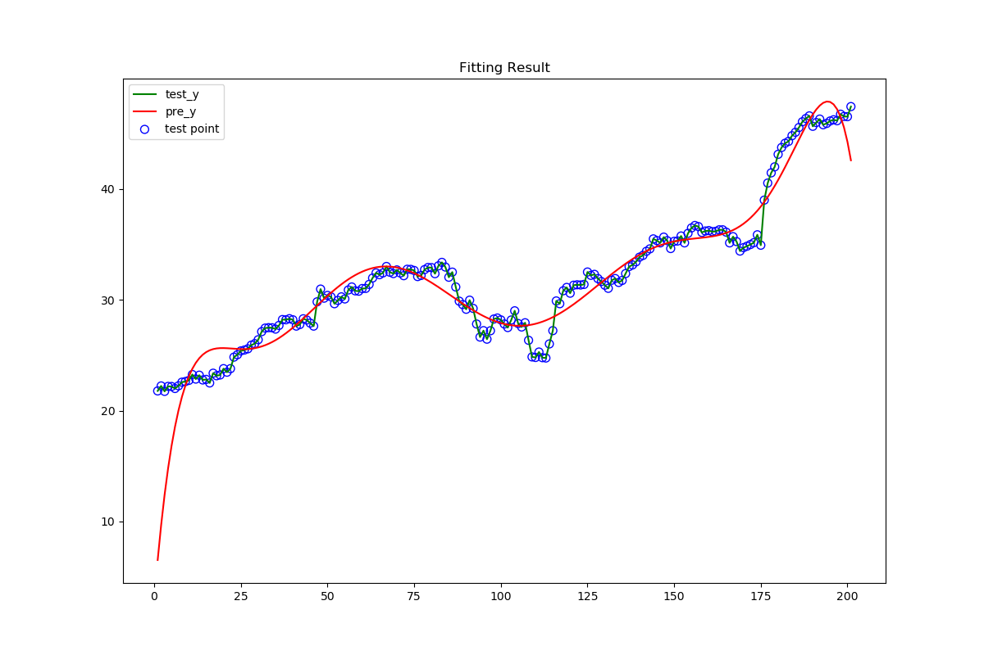
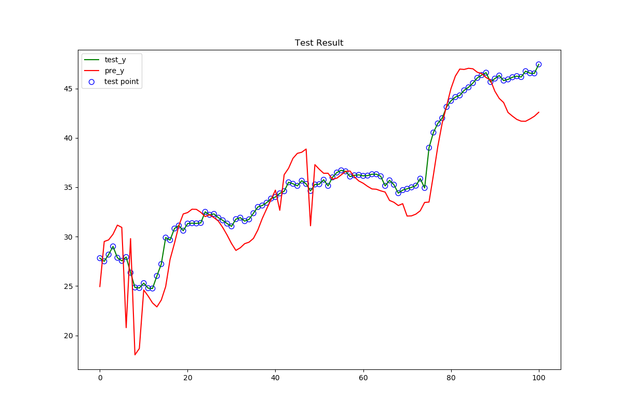
Results with different lambda
Lambda = 20

Slide 7
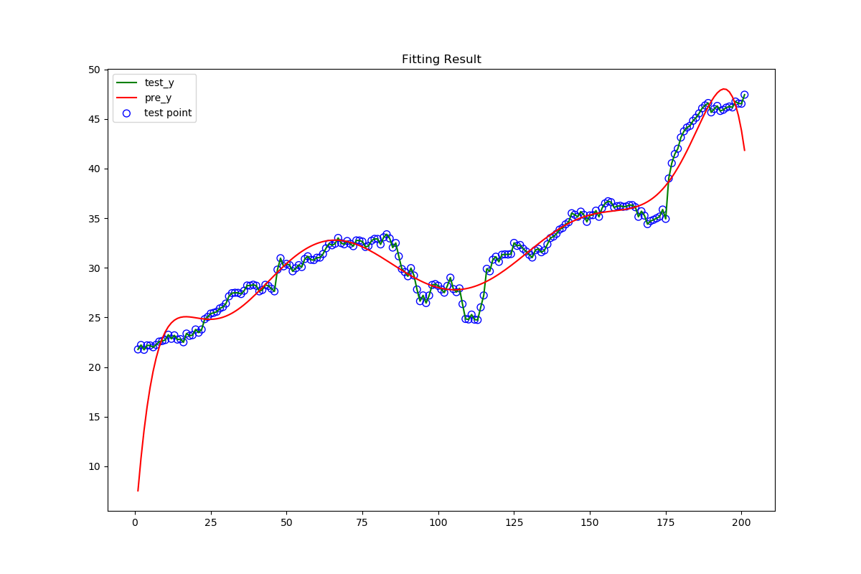
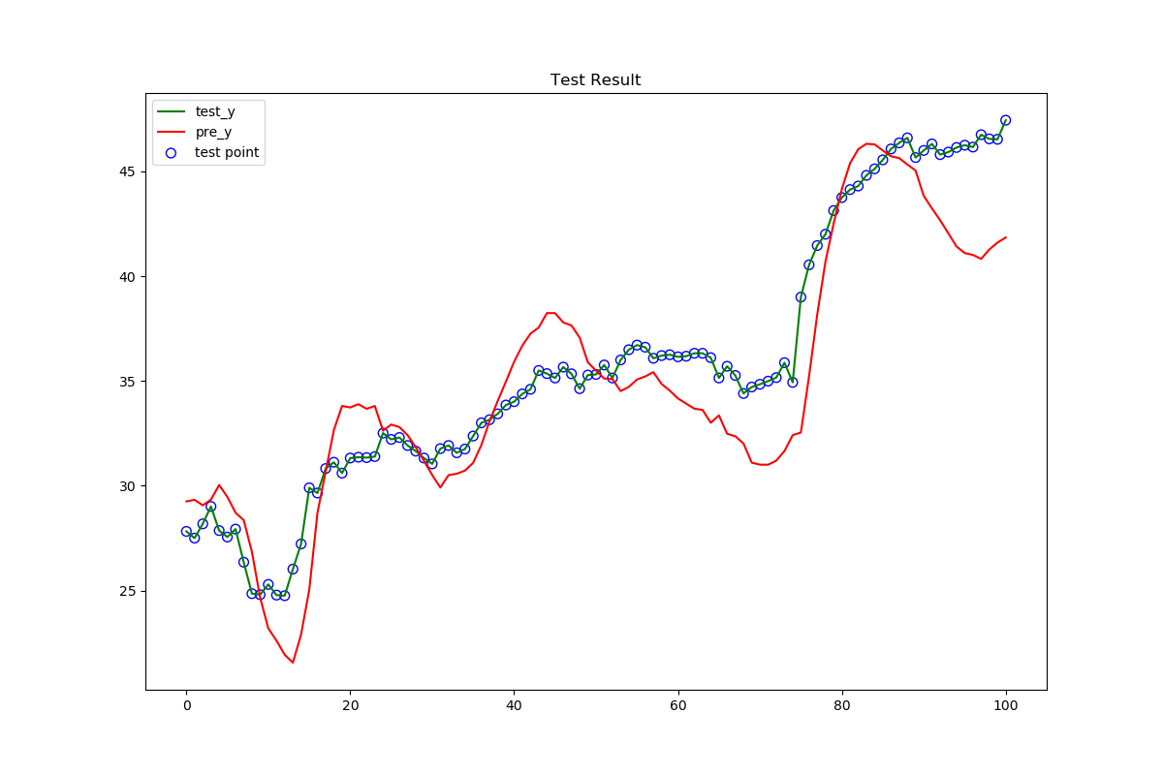
Lambda = 10

Slide 8
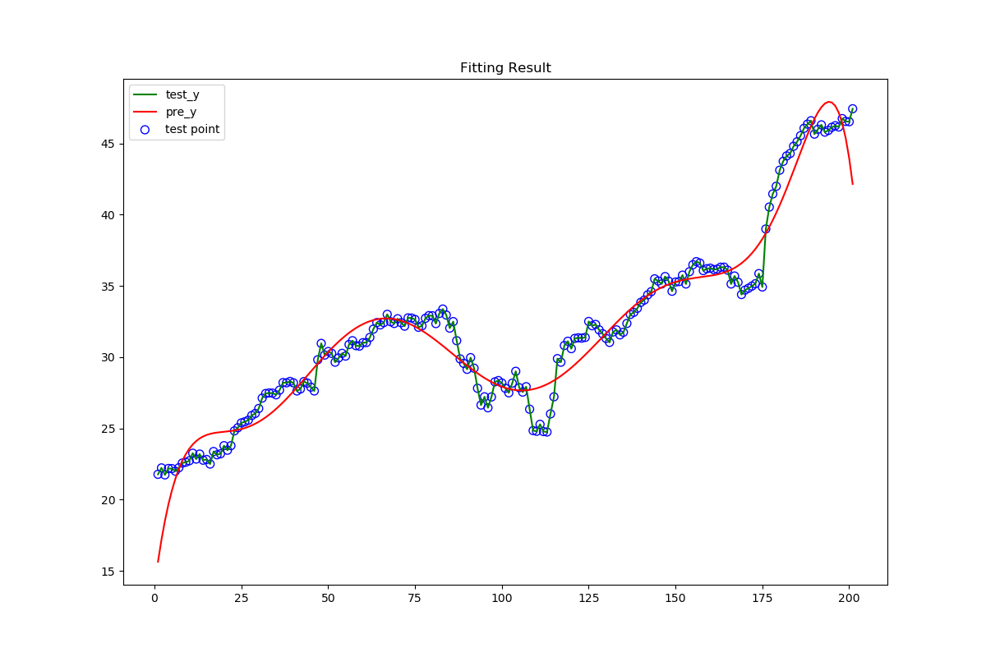
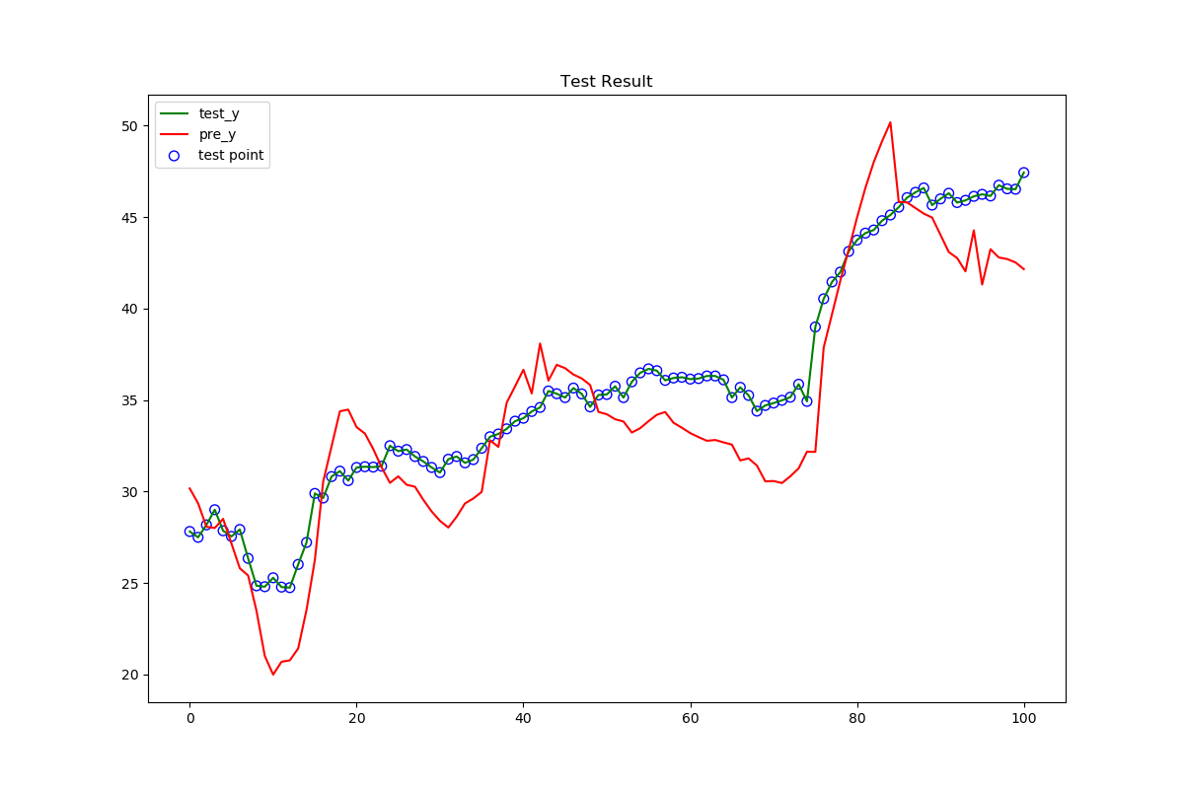
Lambda = 1

Slide 9
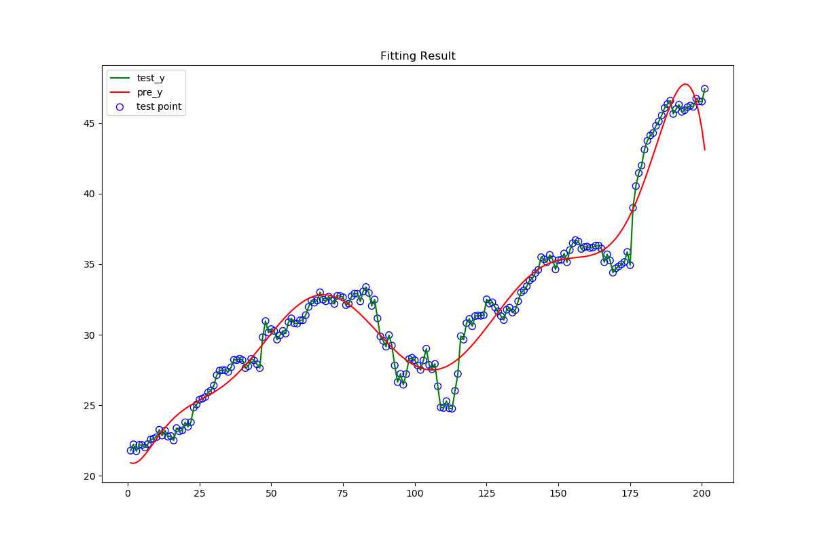
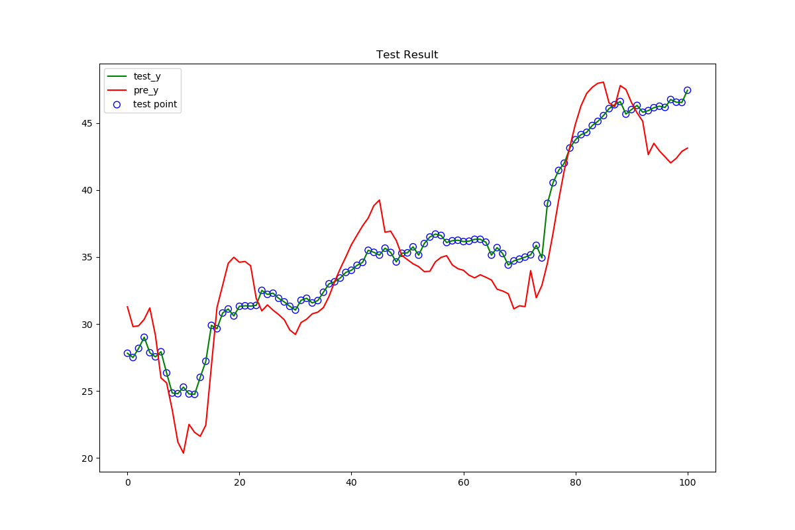
Lambda = 0.2

Slide 10
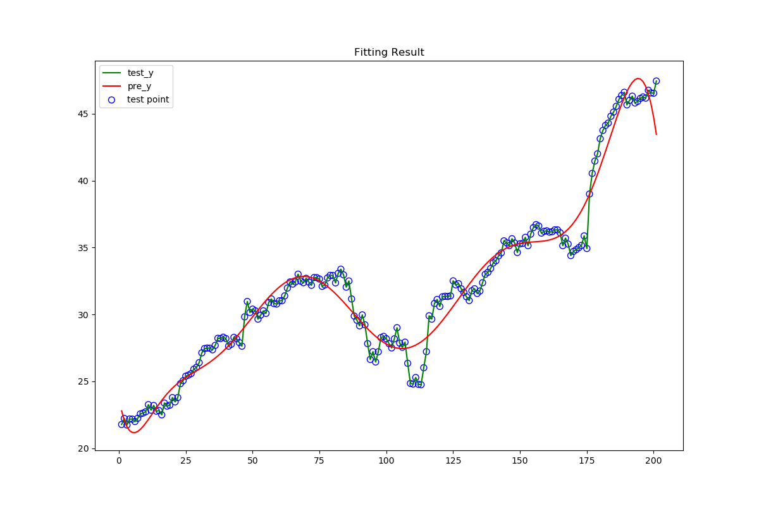
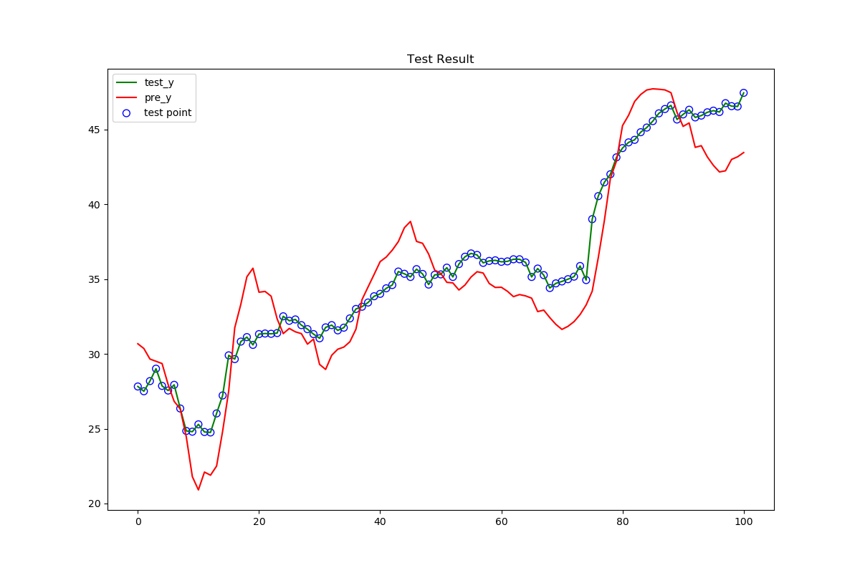
Lambda = 0.02

Slide 11
Result of performance matrix
I consider price rise as positive and reduce as negative
True Positive Rate: 0.48
True Negative Rate: 0.72
Accuracy: 0.57
Precision: 0.75
Recall: 0.48

Slide 12
Use Cases
This algorithm will accept the history dataset as training sets and return the prediction the stock price next day.
Also it will keep extend its training sets to predict a more accurate value.

